Slide 1
Smart Primary Practical

Slide 2
Pam Waite
Science Consultant

Slide 3
Intended Learning Outcomes
You will:
Be more aware of the five types of enquiry in the
Working Scientifically section of the new science curriculum
Be able to consider how science practical enquiry activities can be resourced from the ‘kitchen cupboard’ i.e. using non specialist equipment

Slide 4
Ice-cream without a freezer
Curriculum link – Year 4 States of matter, but …..
To observe a material change state when it is cooled, measuring the temperature at which this happens in degrees Celsius

Slide 5
New resource available this spring from Smart Learning
A book containing two easy to resource practical activities for every topic and age group in the new National Curriculum.

Slide 6
New resource available this spring from Smart Learning
For each topic one activity will be for the teacher to lead, whilst the second activity (on the same theme) is designed for pupils to attempt independently. Hand out

Slide 7
Working Scientifically
There are now 5 types of enquiry named in the new curriculum.
Can anybody name the 7 old ones?

Slide 8
Types of enquiry
OLD | NEW
Observation | Observation over time
Fair Test | Comparative and fair testing
Research | Research using secondary sources
Illustration
Using a model
Basic Skills
Exploration
 | Pattern seeking
 | Identifying, grouping and classifying
Read hand out - definitions

Slide 9
Types of enquiry
Pupils will learn and put into practice the Working Scientifically skills by carrying out a range of practical activities and taking part in the different types of enquiry

Slide 10
Why are there 5 types of enquiry outlined in the new curriculum?
To give more breadth to the type of enquiry work we do in schools – so that enquiry is more than just the fair test!

Slide 11
Why do I need to know about the 5 types of enquiry?
Because your pupils need to know about them! So that they can say which type of enquiry they need to use to answer a science question.

Slide 12
The following practical activities require pupils to use and practice a significant number of ‘Working Scientifically’ skills.
The activities will prompt pupils to raise further questions. You could ask pupils to say which type of enquiry they will need to use in order to find out the answer.

Slide 13

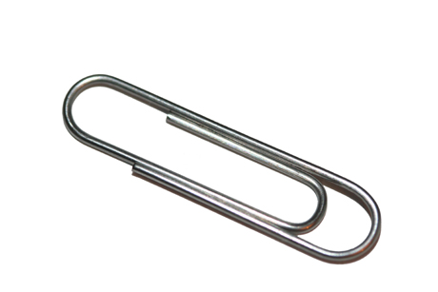
Forces and magnets – Year 3
Attractive butterfly
Paperclip rescue
To show that magnetic forces can act at a distance

Slide 14
Attractive butterfly
Fold a Post It note in half (cut off the sticky bit!) then cut out a paper butterfly.
Attach a paper clip.
Tie a 30cm-ish length of thread to the
paper clip.
Secure the other end of the thread to the
table with a small blob of ‘blu-tack’.
Hold a magnet above your butterfly to
make it fly, without the magnet touching the
paper clip.

Slide 15
Attractive butterfly
‘Flying Butterfly’ challenge
Make the butterfly visit both flowers
without allowing the magnet to touch
the paperclip or the butterfly to drop.
Make a ‘Butterfly Box’ display
(Could be kites, aeroplanes,
helicopters, birds etc.)

Slide 16
Help!
Paperclip rescue
. .
Can you remove the paperclips from the glass
of water using only a magnet?
Predict – which of the paperclips will you be able to rescue?
(You can pick the glass up if you need to)

Slide 17
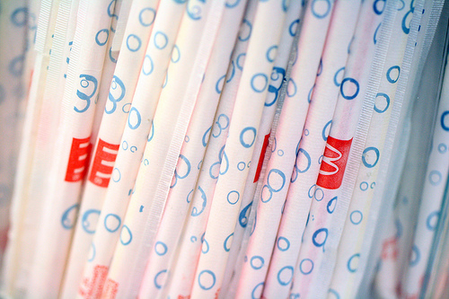
Everyday materials – Year 1
Wiggly worms
To describe the simple physical properties of an everyday material

Slide 18
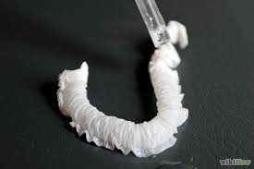
Make a worm, as demonstrated.
Drop water onto the worm, one drop
at a time.
What’s the science?

Slide 19
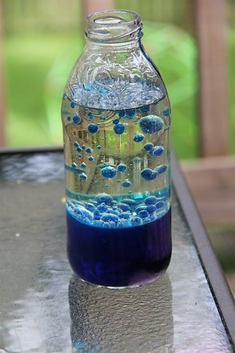
Properties and changes of materials – Year 5
Lovely lava lamps
To demonstrate a non-reversible change during which new materials are made

Slide 20
Drop ¼ of an Alka-Seltzer tablet (other pain relief remedies are available!) at a time, into the plastic bottle full of liquid and observe what happens.
What do you think the liquids are in the plastic bottle?
Can you explain to a colleague what is happening and why?

Slide 21
How Does It Work?
The molecules of water do not mix with the molecules of oil. Food colouring only mixes with water. It does not colour the oil.
When you pour the water into the bottle with the oil, the water sinks to the bottom and the oil floats to the top.
Oil floats on the surface because water is heavier (more dense) than oil.
The Alka-Seltzer tablet reacts with the water to make tiny bubbles of carbon dioxide gas. These bubbles attach themselves to the blobs of coloured water and cause them to float to the surface. When the bubbles pop, the
colour blobs sink back to the bottom of the bottle.

Slide 22
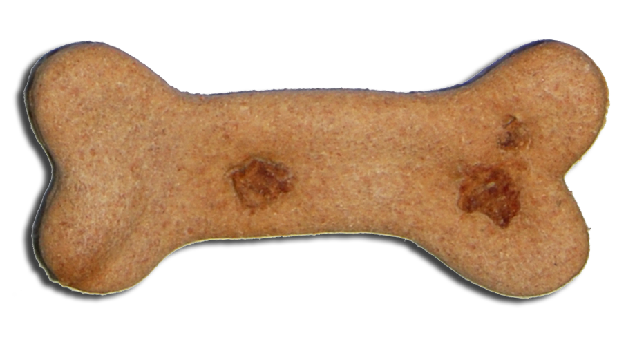
Animals, including humans –
Year 3
Biscuit skeletons
To assess pupil knowledge of the human skeleton

Slide 23
Biscuit skeletons
Using the dog biscuits, construct a human skeleton (not to scale!)

Slide 24
Biscuit skeletons
Label the bones – as a Y3 might.
Teacher trades a common name for a bone with correct name e.g.:
  collar bone for clavicle
  knee cap for patella
  hip bone for pelvis

Slide 25
Biscuit skeletons
Use a diagram to check how accurate you were
Make some of the key organs out of paper and lay over the top of the skeleton
Make an animal skeleton

Slide 26

Electricity – Year 4
Squishy play dough circuits
To introduce the terms ‘conductors and insulators’

Slide 27
Make a simple series circuit using the battery pack and the LED.
Touch the bulb onto the wires VERY briefly or the bulb will burn out!

Slide 28
Now make a simple series circuit using the battery pack and the LED, where the current runs through the play dough. (This recipe does conduct electricity!)

Slide 29
You needed a gap between two pieces of play dough, with one leg of the LED in each piece. Otherwise you have a short circuit with the electricity bypassing the bulb!

Slide 30
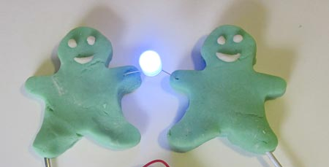
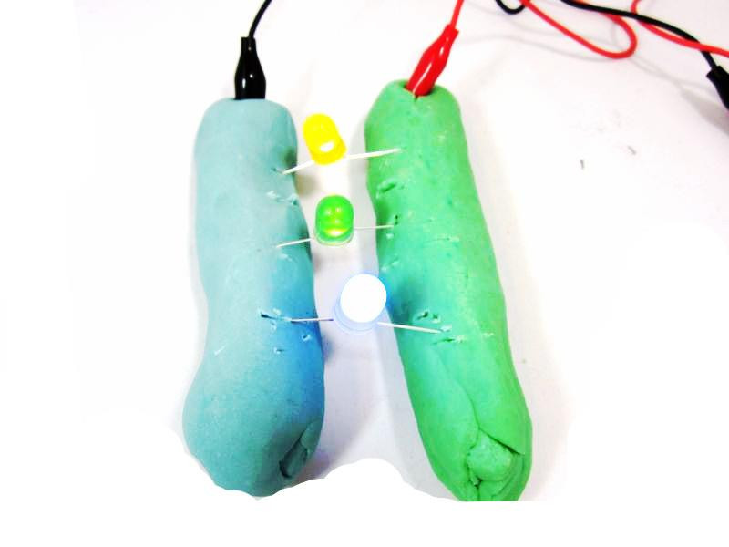
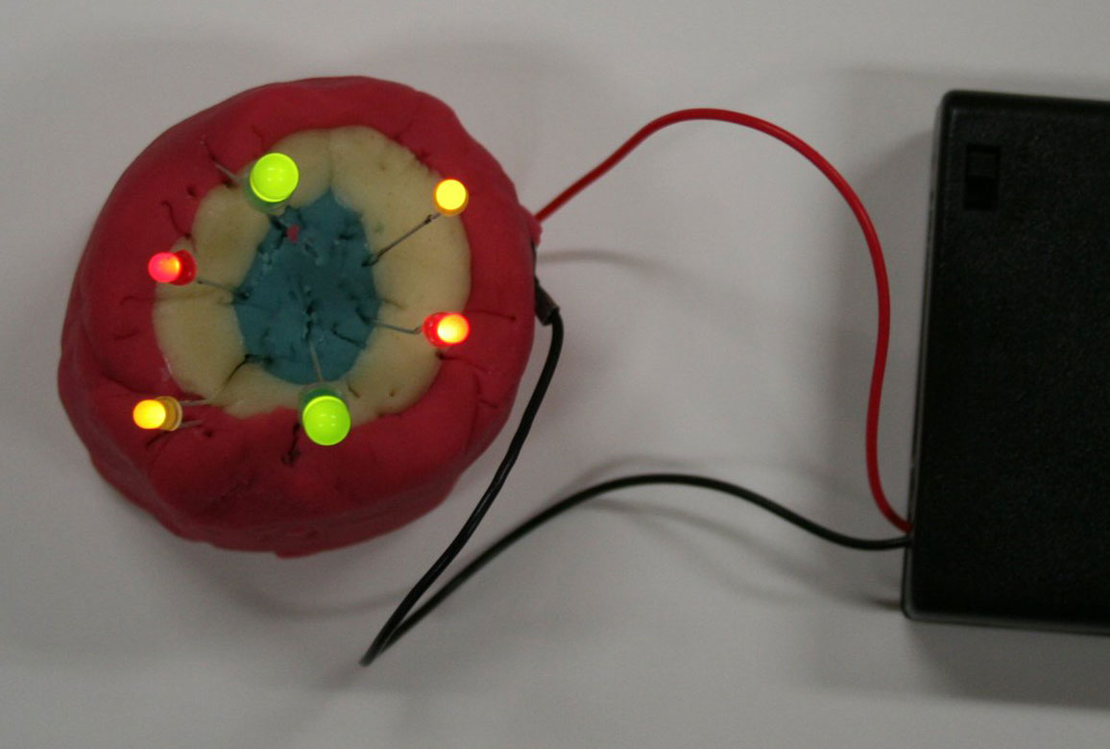

Slide 31
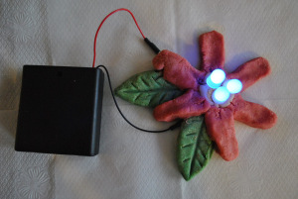
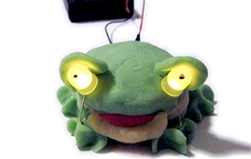
For more inspiration visit the Squishy Circuits Facebook page

Slide 32

Uses of everyday materials –
Year 2
Twist, bend, stretch and squash game
To find out how the shapes of solid objects made from some materials can be changed

Slide 33
Twist, bend, stretch, squash game
Objective – to make a tree!
Rules of the game:
You will be in a team.
You can only shape the dough using the action as called out from the person with the spinner.
You have 5 seconds.
Then pass the dough on to the next person.

Slide 34
Other activities include ….
Animals, including humans – Year 2
Cheerio grab
Light – Year 3 Peep hole box
Sound – Year 4 Visual vibrations
Living things and their habitats – Year 2
Wandering woodlice

Slide 35
Other activities include….
Plants – Year 2 Through the holes
Rocks – Year 3 Fossil formation sandwich
Electricity – Year 6 Steady hand game
Animals, including humans – Year 4 Rubber eggs

Slide 36
We hope you
have enjoyed the
activities we have
shared with you today.
For more information about future publications
and resources, visit the SmartLearning website.

Slide 37
TELEPHONE
01423 206200
EMAIL
admin@smart-learning.co.uk
TWITTER
@smartlearning
@smartsci @smartenglishsl
ADDRESS
Smart Learning Ltd
Unit 4A
Follifoot Ridge Business Park
Pannal Road, Harrogate, HG3 1DP

